Slide 1
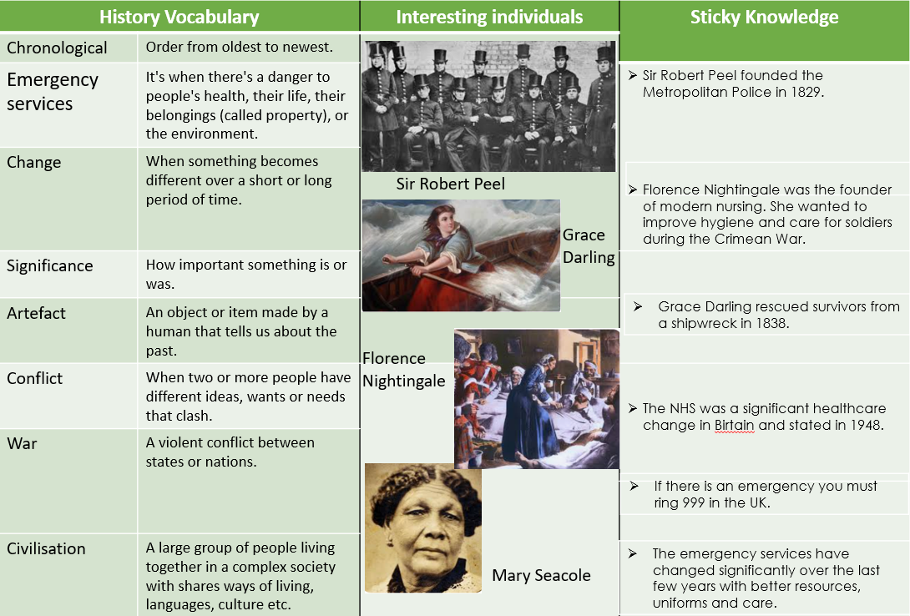

Slide 2
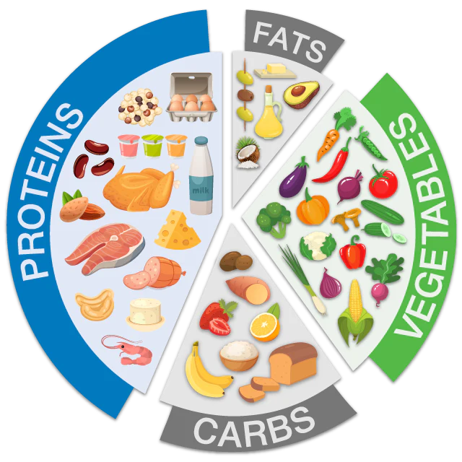
Science: Animals including humans
Subject Specific Vocabulary |  | Food groups | Sticky Knowledge about healthy living
Healthy | Keeping healthy means doing things that are good for your body – things like eating nutritious foods, exercising, brushing your teeth and getting enough sleep.
 |  |  | Keeping healthy means caring for our body so we have enough energy to learn, grow and play.
Diet | Eating a balanced diet means choosing foods in the right amounts from each of the food groups.
 |  |  | Everyone should have their 5 a day. This means five portions of fruit and vegetables to get the right amount of nutrients.
Off-spring | You can refer to a persons children or an animals young as their off-spring.
 |  |  | Humans and animals need food, air, water and shelter to survive.
Exercise | Means to keep your body healthy by running, walking and playing. You will need to feel out of breath if you have exercised properly. | Important facts to know: | A food chain shows what order animals and plants are eaten in.
Disease | A harmful change from normal e.g. a sickness or illness causes by germs. | Know what humans need to survive (including food and water). Know what animals need to survive. Know why it is important to exercise. Know why it is important to eat the right amounts of food. Know why it is important to clean and wash regularly.
 |  |  | It is important not to eat too much sugar and salt. Sugary foods are bad for your teeth and salty foods can lead to heart disease.
Adult | A fully grown animal or plant.
Nutrition | Food we need to live. |  | We should eat a variety of all foods to help keep our bodies happy and healthy.
Develop | To grow bigger, better and become stronger.
 |  |  | Live young are the offspring that has not hatched from an egg.
Survival | Survive usually means to succeed in keeping alive against odds.
Hygiene | Taking care of our body by being clean and making sure we don’t smell.

Slide 3
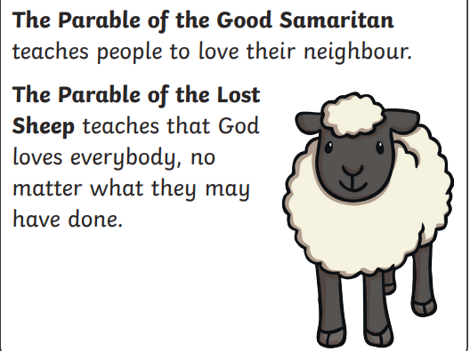
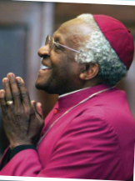
KS1: Forgiveness
Vocabulary |  | Scripture links | Sticky Knowledge
God | The creator of the universe and someone that we worship.
 |  |  | Diwali is a time to exchange gifts, sweets and enjoy delicious feasts, watch firework displays and wear new clothes.
Diwali | A Hindu celebration celebrated with friends and family,
Forgiveness | Excusing or pardoning someone when they have hurt or offended you.
 |  |  | Christians believe they have a responsibility to care for God’s creation.
Respect | A feeling of admiration for someone's qualities or achievements.
 |  |  | Rangoli is a popular Diwali tradition – beautiful patterns made using colourful powders and flowers. It is a sign to bring good luck and welcome the Gods.
Hinduism | One of the major 5 religions in the world and a cultural tradition of South Asia. Our prime minister Rishi Sunak is a practising Hindu. |  | Reincarnation
Parable | Jesus told parables to explain his teachings.
 |  |  | The cross is a very special symbol for Christians, it reminds them of Jesus’ death on the cross which brought forgiveness for the world.
Worship | Showing love and respect to someone or something important. |  | Karma
 |  |  | Jesus taught people about God’s forgiveness through parables.
Sin | Doing something that goes against what God says is right.
Prayer | A way for you to communicate with God.
“Without forgiveness, there is no future … if you can forgive, then you can move on and even help the person you are forgiving to become a better person” – Desmond Tutu

Slide 4
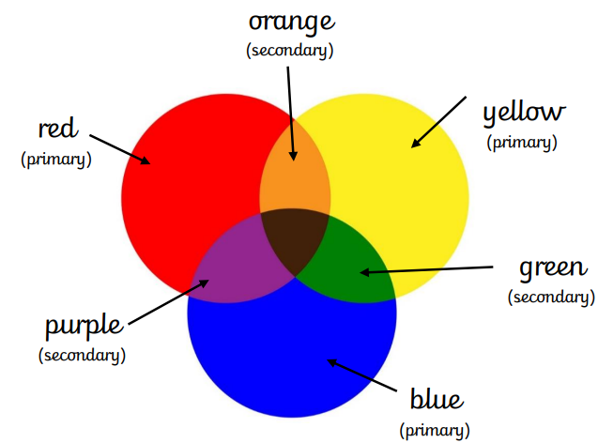
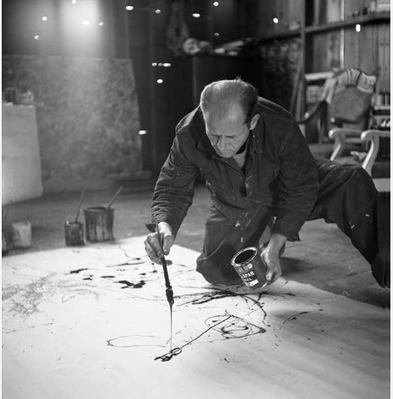
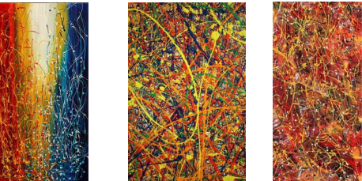
Art Vocabulary |  |  | Sticky Knowledge
Colour wheel | A diagram that shows colours and their relationships to each other. |  | Jackson Pollock used art to express his feelings.’
Abstract | Art that doesn’t look like an object.
 |  |  | Jackson Pollock liked to paint his canvases on the floor which became known as ‘drip painting’
Drip | When paint is allowed to drop off the paintbrush.
Splatter | When paint is splashed onto the paper.
 |  |  | A collage is a collection of different textures or images that can be overlapping each other to create one big picture.
Layer | When more paint is added on top. | Jackson Pollock
Tint | Adding white to make colours lighter.
 |  |  | We can use natural dyes such as beetroots, berries and onion skins.
Tone | Adding black to make colours darker.
Warm colours | Colours that are made from red, yellow and orange.
 |  |  | We can add texture through using glue, sand or items that we might fnd outside such as leaves.
Cool colours | Colours that are made from blue, green and purple.
Primary colours | Primary colours cannot be made out of any colours by mixing. There are three primary colours. Blue, Yellow and Red

Slide 5

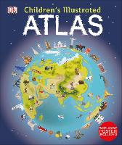
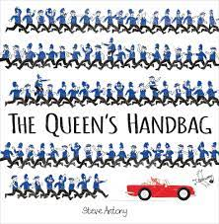
Geography Vocabulary |  | Interesting texts | Sticky Knowledge about materials
Ocean | A large area of salt water.
 |  |  | Maps help us find out information about different places.
Continent | The world's main continuous expanses of land.
 |  |  | We can use atlases or we could use the internet to help us find a location.
East | A direction on a map or compass. This is opposite to west.
 |  | Key questions to ask …
West | A direction on a map or compass. This is opposite to East. | Why are maps important? What can you find in an atlas? Can you sort the continents and oceans into smallest and biggest? Which continent would you like to live on and why? | We have seven continents on our Earth.
Equator | An imaginary line around the centre of the Earth. It is very hot at the Equator. It divides the Earth into the north and south hemispheres.
 |  |  | We have five oceans on our Earth.
Northern Hemisphere | One half of the Earth, north of the equator. |  | Asia is the largest continent and the Pacific ocean is the largest ocean.
Southern hemisphere | One half of the Earth, south of the equator.
 |  |  | A city is a place where many people live closely together. Cities bring together a great variety of people from different backgrounds. They offer more jobs, more schools and more shops.
Climate | The long term weather conditions of an area.

