Slide 1
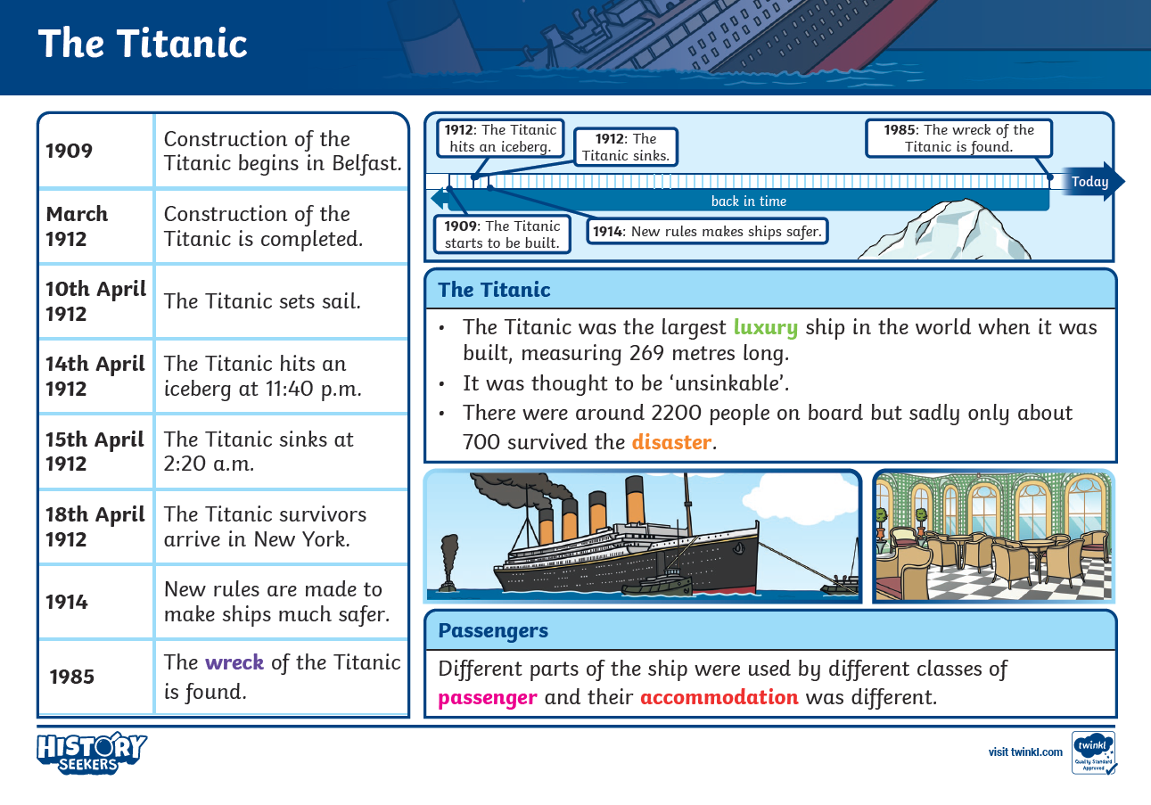
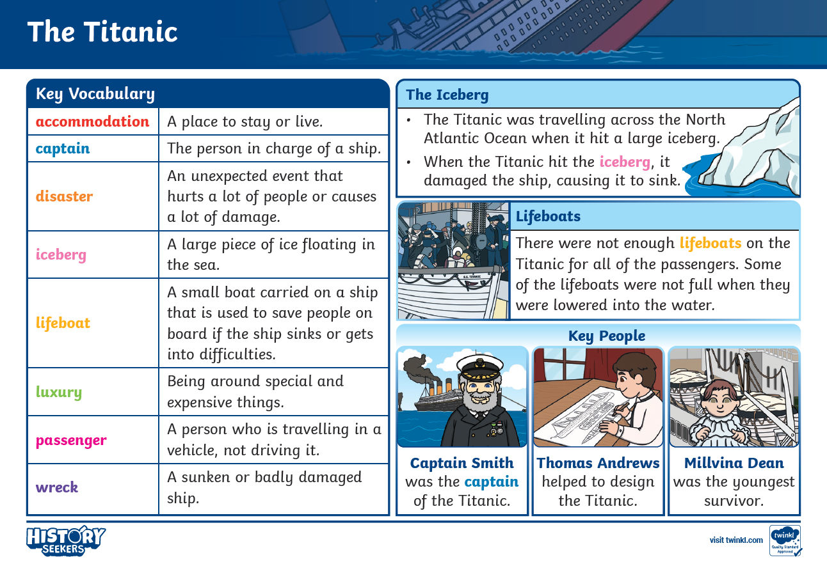
In Spring term, we are on a ‘History’ focus where we look at the Titanic.

Slide 3

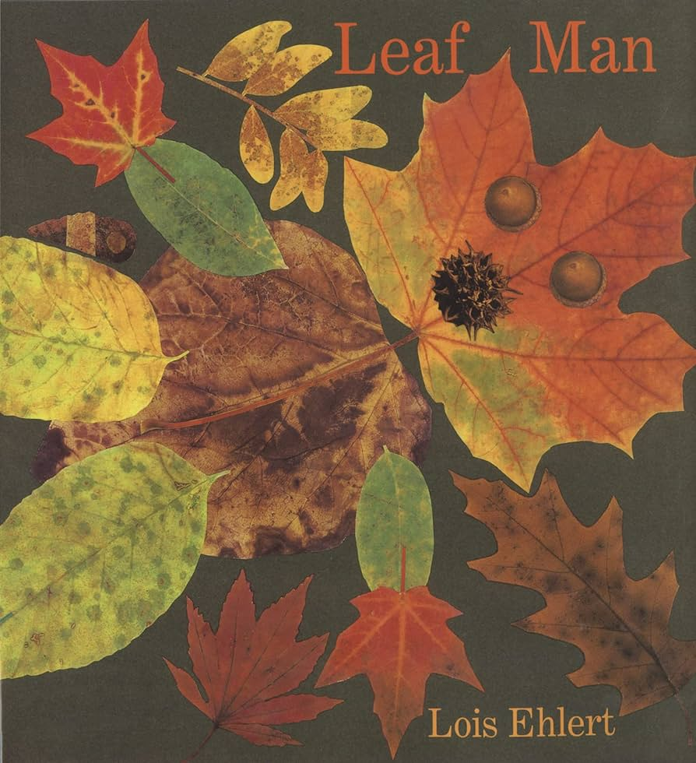
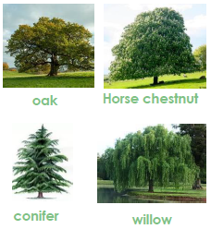
KS1: Plants and Trees knowledge
Subject Specific Vocabulary |  | Interesting Book | Sticky Knowledge about seasonal change
Roots | It is the part of a plant that is usually hidden under the ground. They make the plant stable and give it nutrients.
Crown | The crown is made up of the leaves and branches at the top of the tree.
 |  |  | An allotment is a garden where people grow fruits, vegetables, herbs and flowers.
Deciduous | Deciduous trees are trees that shed their leaves in the autumn and grow new leaves in the summer.
 |  |  | A plant has leaves, roots, stems and flowers.
Evergreen | Evergreen trees are the same as coniferous trees. They do not lose their leaves in autumn.
 |  |  | An evergreen tree keeps its leaves all year round and a deciduous tree loses its leaves over winter.
Blossom | Is the mass of flowers created by a tree. Almost all fruit bearing trees have blossom. The blossom is usually the best in spring. |  | An evergreen tree keeps its leaves all year round and a deciduous tree loses its leaves over winter.
Bulb | Bulbs are underground masses of food storage from which plants grow.
 |  | Common trees found in the UK | Trees have trunks, branches and leaves. Different trees grow different items such as apples, pinecones and walnuts.
Trunk | A trees trunk holds up its crown, protects its inner parts and works like a pipeline moving all the essential materials to the different parts of the tree.
 |  |  | A herbarium is a collection of dried plants. These are made to help identify plants and to look at them closer.
Stem | The stem is the main part of the plant. It supports the weight of the leaves, as well as the flowers or fruit.
Woodland | A woodland is a habitat where trees are the dominant form of plant. |  | Some seasons need thicker clothes and some need thinner clothes.
 |  |  | Trees and shrubs take in water and carbon dioxide and give out oxygen.
Habitat | The place where a plant or animal lives. There are different types of habitat such as forest, river or grassland.
Oxygen | Oxygen is used by animals and plants in the breathing process. |  | There are 4 seasons throughout the year and these are spring, summer, autumn and winter.

Slide 4


